Slide 1
Project Presentation of CO-OP Project at Industry (Module-2) (22CS421)
On
FitTrack AI – Privacy Preserving Multi Camera Keypoint Fusion
Harsh Raj
2210991623
Supervised By
Dr. Gurpreet Singh
Department of Computer Science and Engineering,
Chitkara University, Punjab

Slide 2
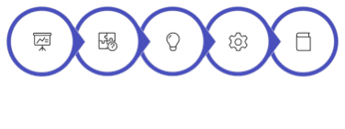
Presentation Agenda
• Introduction and Background
• Problem Definition
• Proposed Solution and Objectives
• System Requirements
• Literature Review
• Methodology & Problem Solving
• System Design
• Implementation Details
• Major Findings and Results
• Conclusion and Future Scope • Students and home users require affordable solutions. • Privacy-first design increases user trust.
Introduction
Problem definition
Proposed solution
System requirement
Literature review
2

Slide 3
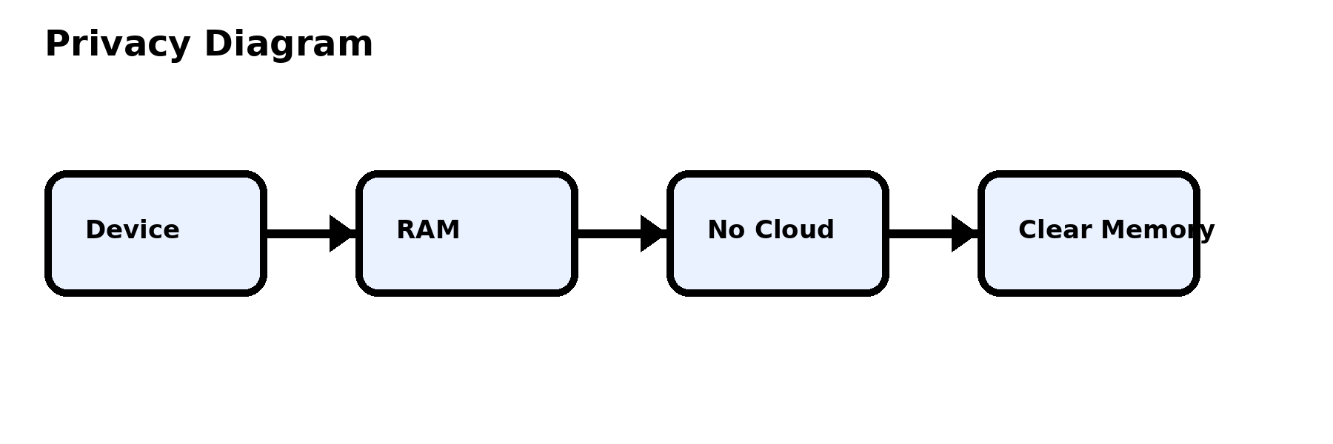
Introduction
• The intersection of healthcare, physical fitness, and AI is growing rapidly.
• Standard 2D webcams can now track human movement via marker-less pose estimation.
• Replicating compound routines at home without a trainer often leads to injury.
• Cloud-based fitness apps introduce severe vulnerabilities regarding personal data privacy.
• Traditional systems store sensitive video data online. • FitTrack AI eliminates cloud dependency risks.
3

Slide 4
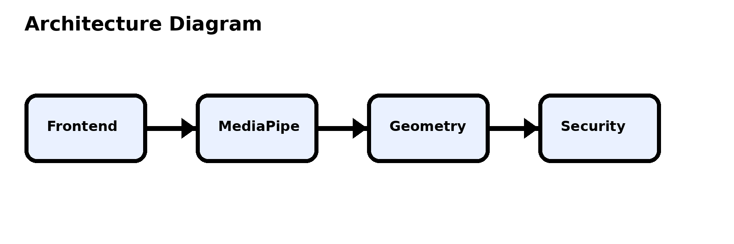
Background & Motivation
• FitTrack AI was motivated by the high prevalence of home-based injuries during heavy lifts.
• Personal trainers are prohibitively expensive for students.
• There is a critical demand for automated, cost-effective biomechanical analysis that does not compromise user privacy.
• Lighting conditions should not affect posture accuracy. • Deterministic geometry ensures reliable results.
4

Slide 5
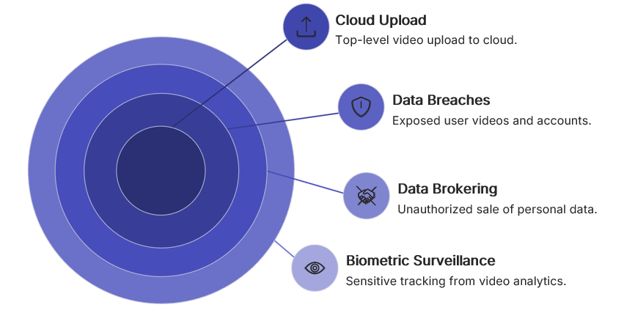
Problem Definition: Privacy
• Cloud Dependency Risks: Contemporary AI fitness utilities are overwhelmingly cloud-dependent.
• Transmitting video feeds from private residential spaces to third-party servers exposes users to:
- Severe risks of data breaches.
- Unauthorized corporate data brokering.
- Potential biometric surveillance.
• Fully edge-computed architecture improves speed. • Zero-trust approach guarantees local privacy.
5

Slide 6
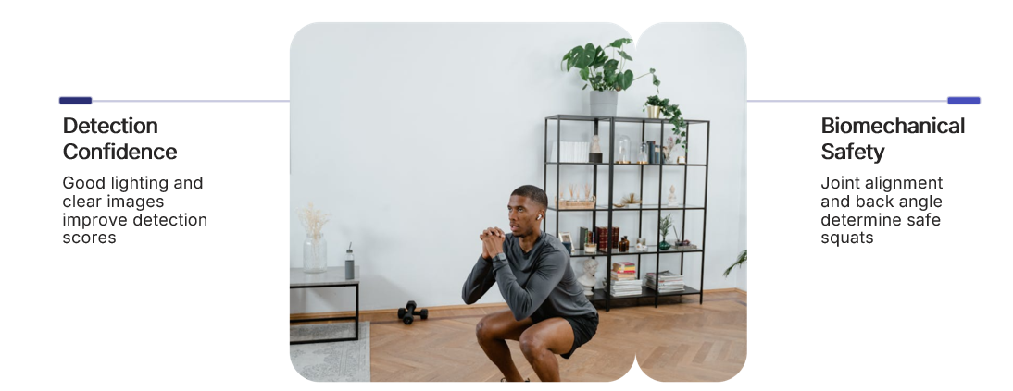
Problem Definition: Accuracy
• Detection Confidence ≠ Safety: Standard open-source scripts evaluate performance based on 'Detection Confidence'.
• This metric strictly measures lighting and clarity, not biomechanical safety.
• Approving a dangerous squat merely because the room is well-lit is harmful to the user.
• User-friendly interface designed for non-technical users. • Real-time feedback increases training safety.
6

Slide 7
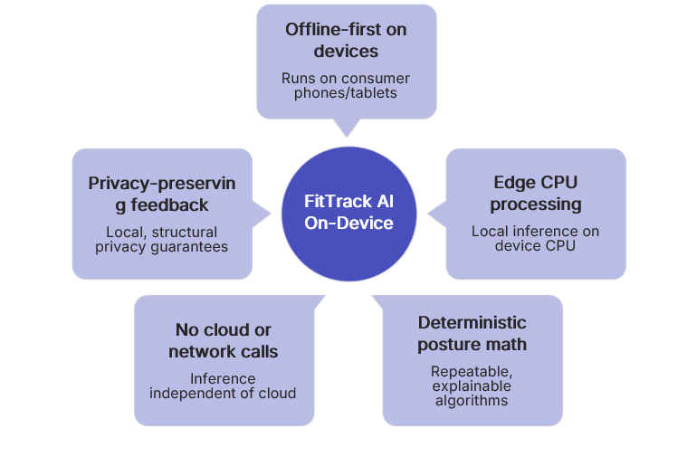
Proposed Solution
• FitTrack AI is a fully localized, edge-computed software solution.
• Offline-first architecture with no external network calls during inference.
• Provides structural privacy guarantees.
• Uses deterministic mathematics to evaluate posture accurately.
• Efficient CPU-based processing reduces hardware costs. • Optimized for standard consumer devices.
7

Slide 8
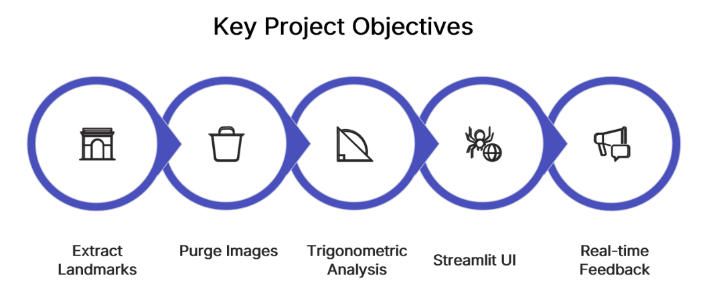
Key Project Objectives
• Extract only numerical landmarks and purge image matrices instantly.
• Use deterministic trigonometric algorithms for joint angle analysis.
• Build an accessible Streamlit-based UI for real-time feedback.
• Comparative analysis performed on modern pose systems. • Lightweight MediaPipe selected after evaluation.
8

Slide 9

System Requirements
• Intel Core i5 recommended with 8GB RAM.
• Uses Python 3.9+, Streamlit, MediaPipe, OpenCV, NumPy.
• Supports 720p/1080p webcam input.
• Lightweight CPU-based execution.
• Mathematical calculations improve posture validation. • Modular design supports future scalability.
9

Slide 10
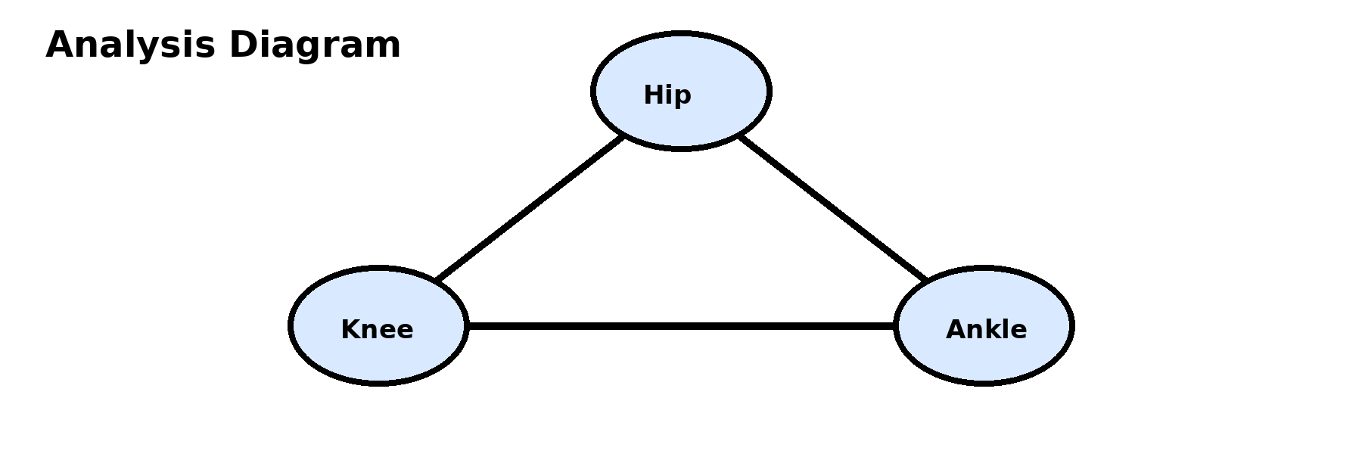
Literature Review
• Compared IMU sensors, depth cameras, YOLO, OpenPose, and MediaPipe.
• MediaPipe selected due to lightweight CPU optimization.
• Existing cloud systems create privacy and latency issues.
• FitTrack AI resolves both privacy and biomechanical accuracy concerns.
• Four-layer architecture improves maintainability. • Memory management prevents data persistence.
10

Slide 11
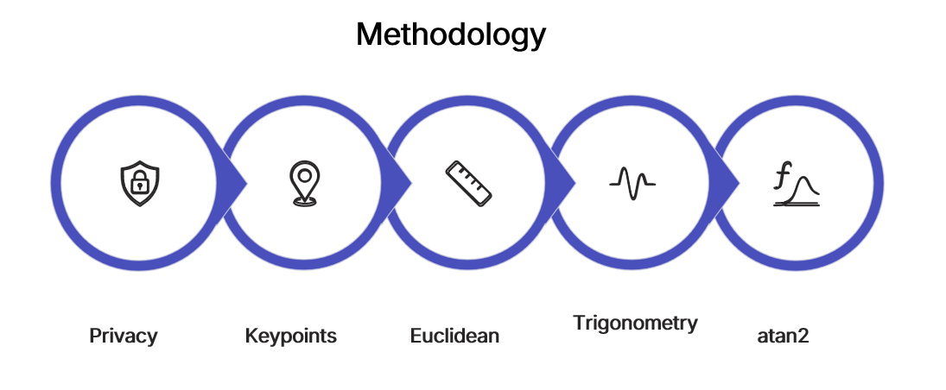
Methodology
• Offline-first privacy-by-design architecture.
• Transitioned from confidence-based evaluation to Euclidean geometry.
• Uses keypoint coordinate extraction and trigonometric calculations.
• Modular architecture separates frontend and backend logic.
• atan2 function provides stable angle computation. • Accurate angle correction handles edge cases.
11

Slide 12
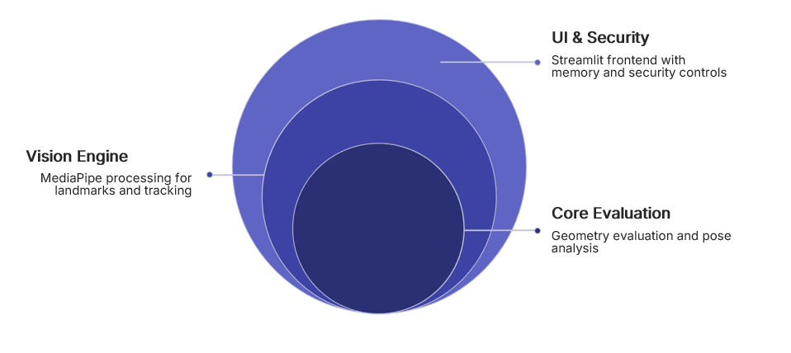
System Architecture
• Layer 1: Streamlit UI Layer.
• Layer 2: MediaPipe Vision Engine.
• Layer 3: Geometry Evaluation Core.
• Layer 4: Memory Management and Security.
• Ensures secure and efficient posture analysis.
• Streamlit frontend improves usability. • OpenCV visualization enhances posture understanding.
12

Slide 13
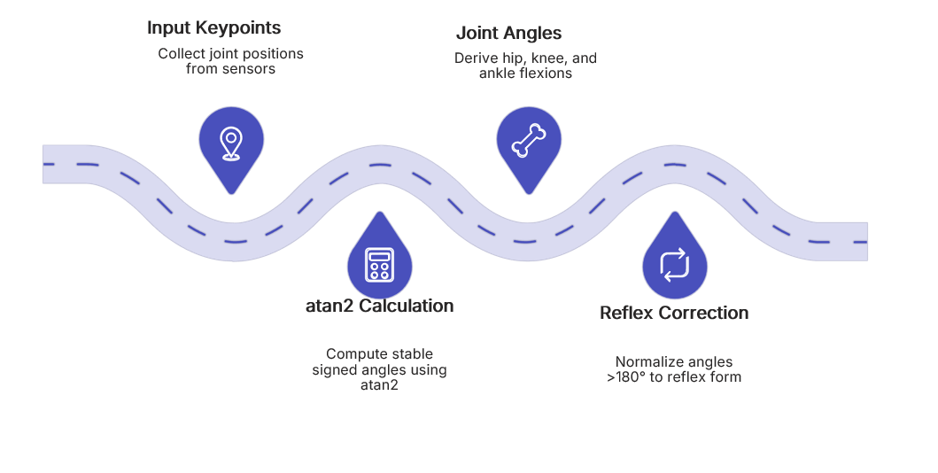
Mathematical Engine
• Uses math.atan2 for stable angle calculations.
• Calculates hip, knee, and ankle flexion angles.
• Corrects reflex angles greater than 180°.
• Provides deterministic posture analysis independent of lighting.
• Real-time alerts successfully detect dangerous posture. • Fast inference enables smooth user experience.
13

Slide 14
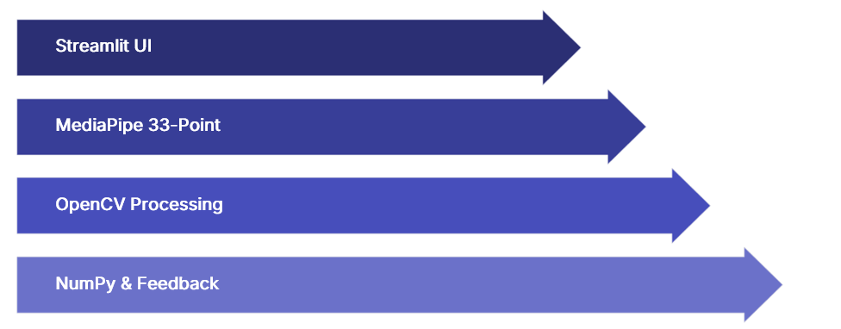
Implementation Details
• Developed using Python and Streamlit.
• MediaPipe extracts 33-point skeletal topology.
• OpenCV handles image processing and rendering.
• NumPy manages coordinate arrays and calculations.
• Extensive testing improved robustness. • Graceful error handling prevents crashes.
14

Slide 15
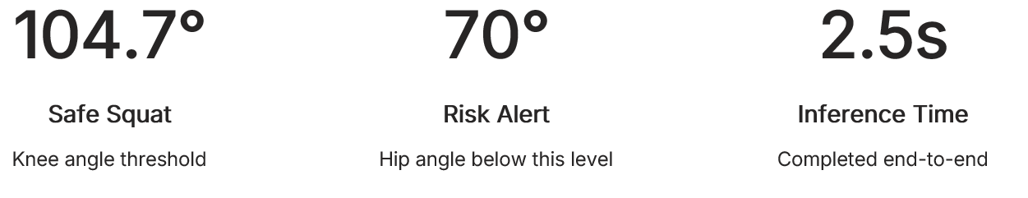
Major Findings & Results
• Accurate squat posture detection achieved.
• Safe squat detected at Knee Angle ≈ 104.7°.
• Dangerous spinal collapse detected at Hip Angle < 70°.
• Entire inference completed in under 2.5 seconds.
• Future upgrades include live webcam support. • System can expand to multiple exercise categories.
15

Slide 16
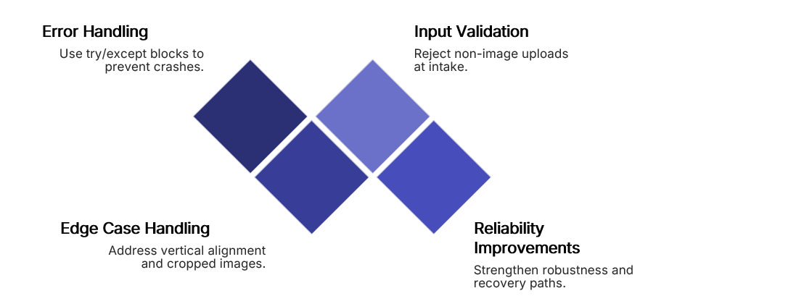
Testing & Validation
• Tested edge cases like vertical alignment and cropped images.
• try/except blocks prevent application crashes.
• Non-image uploads rejected successfully.
• Robust error handling improved reliability.
16

Slide 17
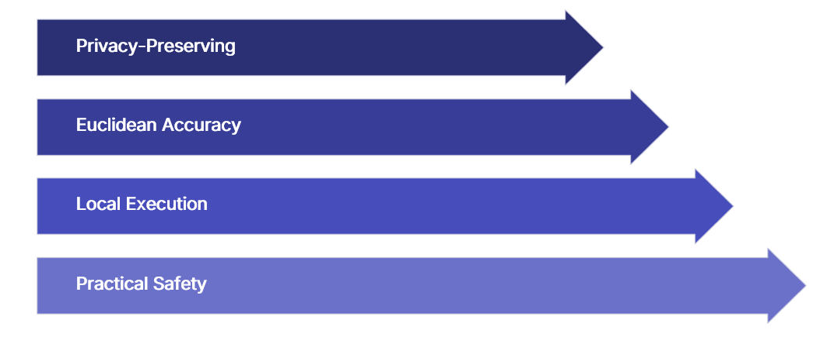
Conclusion
• FitTrack AI delivers privacy-preserving posture analysis.
• Euclidean geometry improves biomechanical accuracy.
• Fully local execution removes cloud dependency.
• Demonstrates practical AI-based fitness safety solution.
17

Slide 18
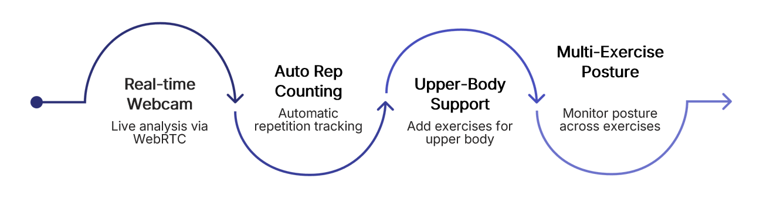
Future Scope
• Real-time webcam analysis using WebRTC.
• Automatic repetition counting.
• Support for upper-body exercises.
• Expansion toward multi-exercise posture monitoring.
18

Slide 19
References
• MediaPipe Pose – Real-time Human Pose Estimation.
• OpenCV Library Documentation.
• NumPy Scientific Computing.
• Python math module documentation.
• Streamlit Official Documentation.
19

Slide 20
Thank You
20

